Slide 1
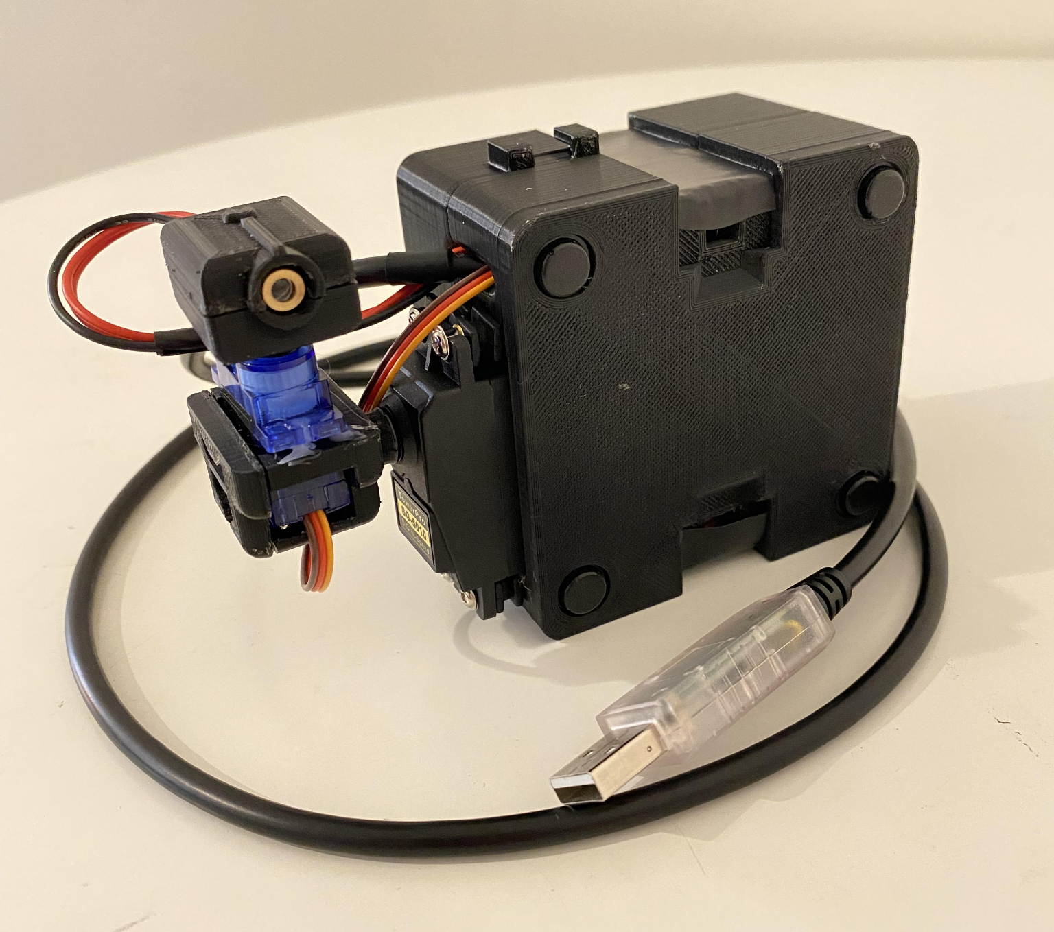
Autolaser
Ian Schuster and James Garrett Advisor: Fred Annexstein

Slide 2
Goals
Build a full range of motion laser pointer assembly
Develop a Python script to take in a video stream and output balloon locations
Connect the two systems such that the laser pointer finds and points at the balloons

Slide 3
Intellectual Merits
This project takes on a few different scopes:
3D printing
Soldering electronics
Utilization of imaging libraries to recognize the balloons
Use of an Arduino to send commands to servos

Slide 4
Broader Impacts
This project is able to take new and exciting technologies such as image recognition and 3D printing and combine them together in a new way. Often times we as programmers can become solely focused on the software side of things and we hope that our demo can help inspire others to experiment more with applying their programing skills in projects with a physical side of things like we have in our demo.

Slide 5
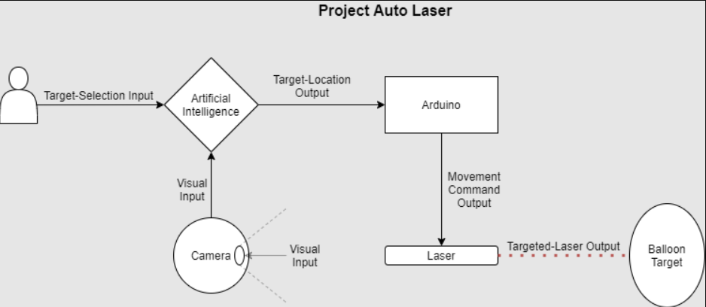
Design Specifications
Python Script

Slide 6
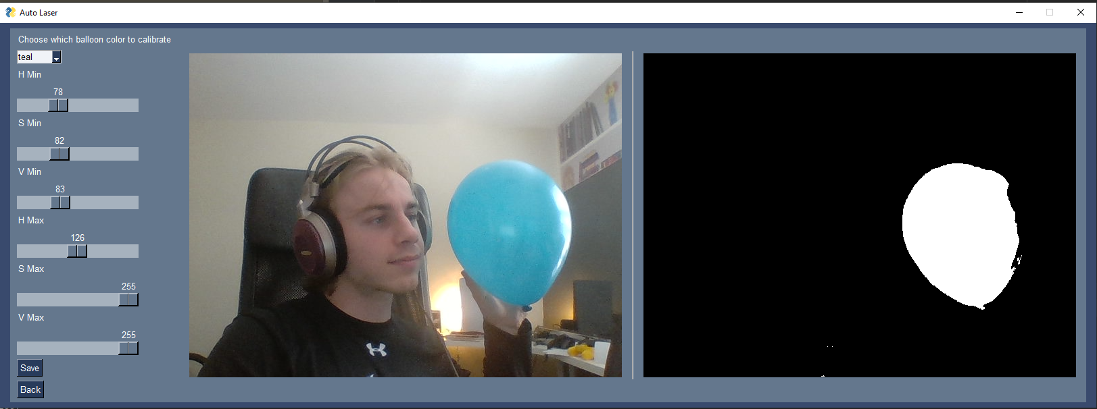
Technologies
3D printed housing
Arduino
Laser
Servos
Balloon image recognition
Python
Camera system
OpenCV
PySimpleGUI

Slide 7
Milestones
Conception of the project idea
Building of the 3D printed assembly
Connection and control over the servos
Software which finds balloon locations
Final connection of software and hardware together
Demo of the project

Slide 8
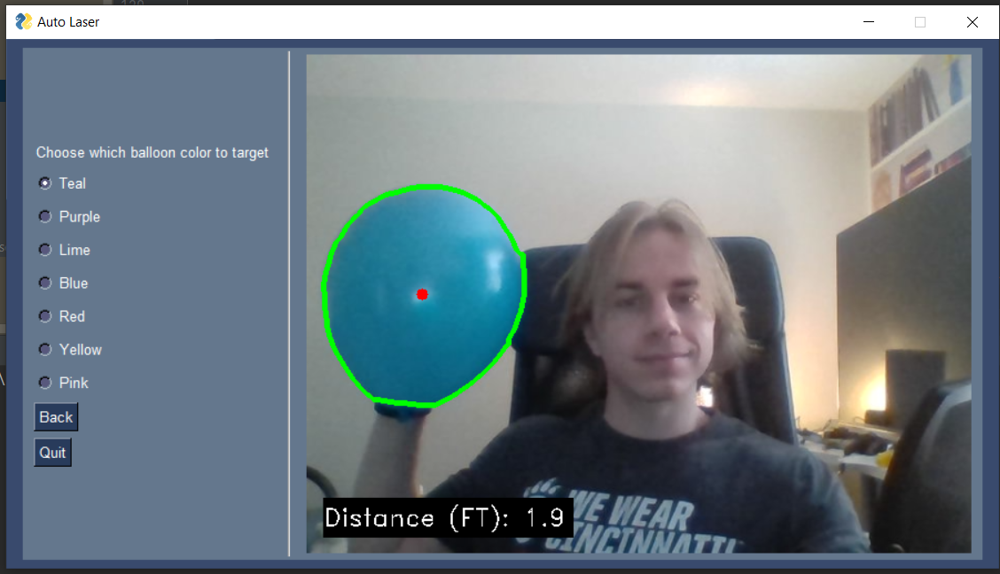
Results
The 3D printed housing is fully assembled
A method for real-time communication between imaging script and arduino is established
A intuitive GUI has been created to improve ease of use and increase the overall quality of the software

Slide 9
Challenges
Assembling the project proved to be difficult since none of the group members had much prior experience with soldering electronics or splicing wires
Initiating an interface that can enable real-time communication between the computer and arduino
Developing a Python script which can accurately and quickly recognize balloon locations via video stream
Originally we wanted a laser powerful enough to pop balloons, however this would require much more power, as well as raise safety concerns.

